Slide 1

RDM services – getting the balance right
Jonathan Rans
Digital Curation Centre
This work is licensed under the Creative Commons Attribution 2.5 UK: Scotland License.
Notes:
Next Jonathan will walk us through scoping pilot services and getting the balance right.

Slide 2
What do we mean by service?
How are we defining a service?
  A means of delivering value to customers by facilitating outcomes customers want to achieve but without the ownership of specific costs and risks.
What do we mean by the term ‘customer’?
Notes:
Service – we have borrowed the description defined in the ITIL service management approach
Does it make sense to use the term customer when researchers are reluctant consumers? In fact researchers only form part of the service’s customer base – consider who

Slide 3

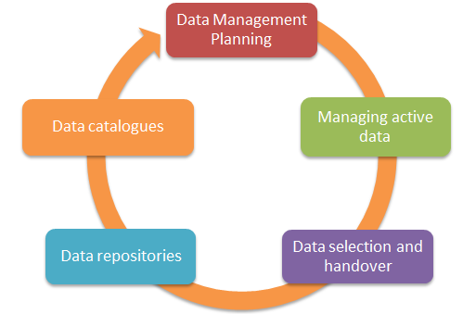
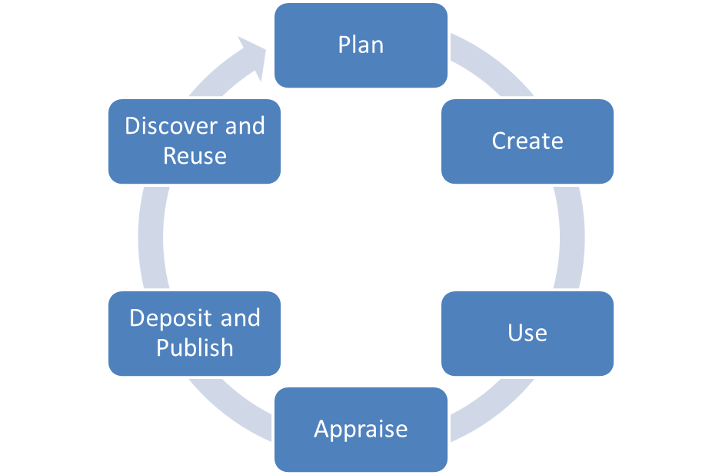

Service development strategy
Notes:
We have found high-level support diagrams very useful when we’re working with HE institutions, focussing discussions on the areas in which we would expect to find support activity of some kind. Of course, this is a huge simplification and the reality is far more nuanced.

Slide 4
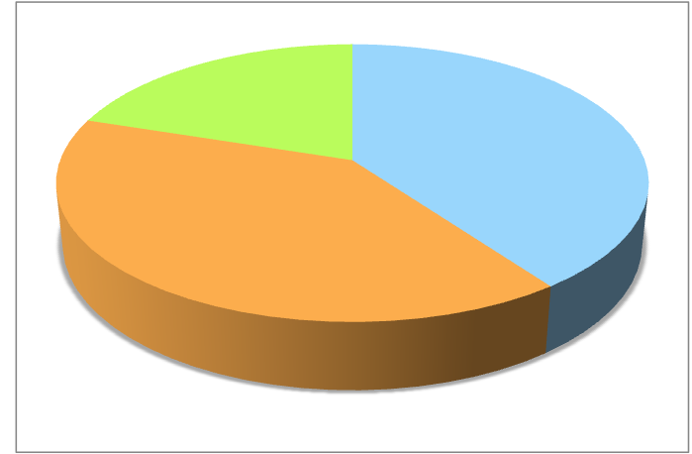
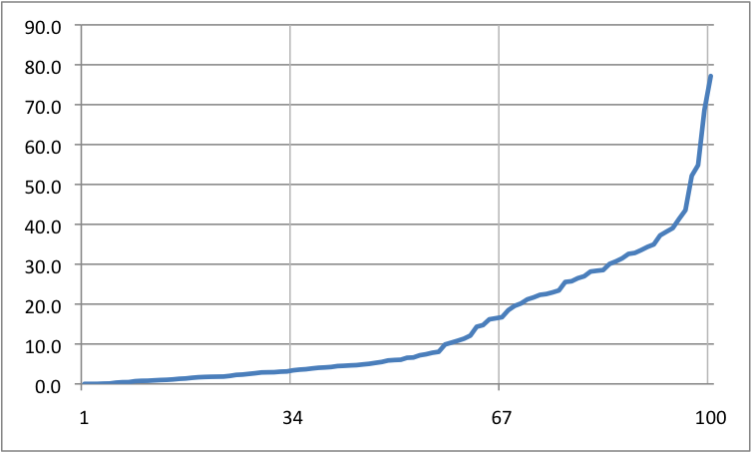
The varied environment
60 Uk Higher Education Institutions responded to DCC survey 2015, of 132 invited
Research-active institutions well represented -
77%
Research income % of total
20%
3%
Percentiles
Income range percentiles - split into 3 groups across all 161 HEIs
Notes:
These figures come from HESA – the higher education statistics authority. Our own survey of UK institutions indicates that there is a huge range in size and research intensity across the board, so when you’re having a discussion about services it’s useful to bear in mind that what is sensible or appropriate in one context might not be in another. Example – automated systems for tracking research outputs.

Slide 5
Where to start?
Policy sets the scope of a service’s capability
Important elements
  Clearly stated coverage
  Well defined roles and responsibilities
  Research data definition
Institutional policy should reflect the external context
Notes:
Which researchers are subject
The roles and responsibilities of all stakeholders including the institution

Slide 6
Three examples
University of Melbourne policy on research data and records
  http://www.unimelb.edu.au/records/pdf/research.pdf
Perdue research repository digital preservation policy
  https://purr.purdue.edu/legal/digitalpreservation
University of Leeds RDM policy
  https://library.leeds.ac.uk/research-data-policies
Notes:
Melbourne: Scope includes the mandatory use of laboratory notebooks for all scientific projects.
Perdue: Defines four types of data object and details the assessment and preservation steps associated with each
Leeds: ‘In addition to any specific funder requirements a data management plan must be created for each proposed research project or funding application to allow costing and infrastructure planning.’

Slide 7
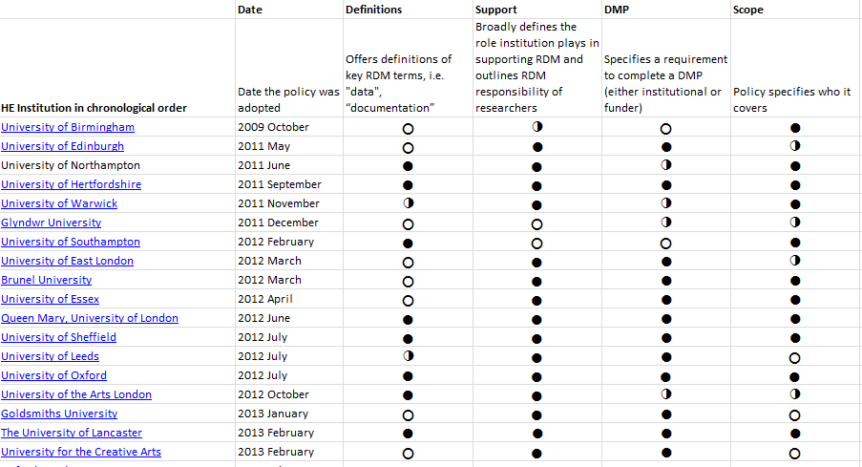
UK policy examples
http://www.dcc.ac.uk/resources/policy-and-legal/institutional-data-policies

Slide 8


Other resources
LEARN project guidelines for developing an RDM policy
http://blogs.ucl.ac.uk/learn-project/files/2016/01/red_LEARN_Elements_of_the_Content_of_a_RDM_Policy.pdf
Canadian government brief on RDM policies
http://www.science.gc.ca/default.asp?lang=En&n=1E116DB8-1
Notes:
Comprehensive brief on RDM policy – Kathleen Shearer – very comprehensive resource which covers policy context in various areas – UK, USA, Australia, EU, etc.

Slide 9

Building your approach

Slide 10
Capability models can help
Focus on what needs to be delivered and not how
Notes:
We are currently developing capability models as a framework for assessing RDM services and formulating a strategy for development. Our aim is to make these applicable both to institutions that are just starting out and to those that already have infrastructure components in place. For the latter this acts as a kind of healthcheck of current direction. These models enable us to focus on what capability you wish to deliver

Slide 11
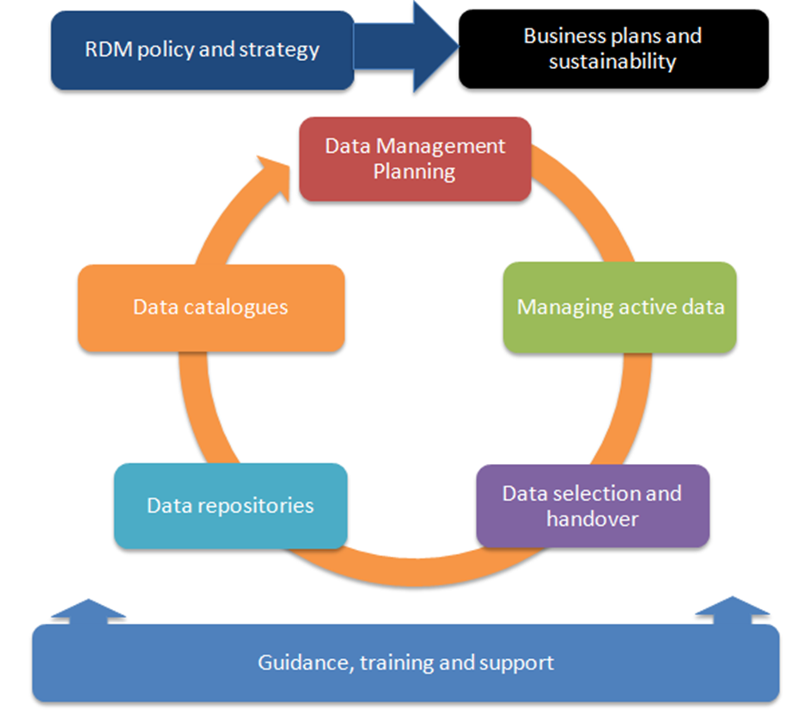
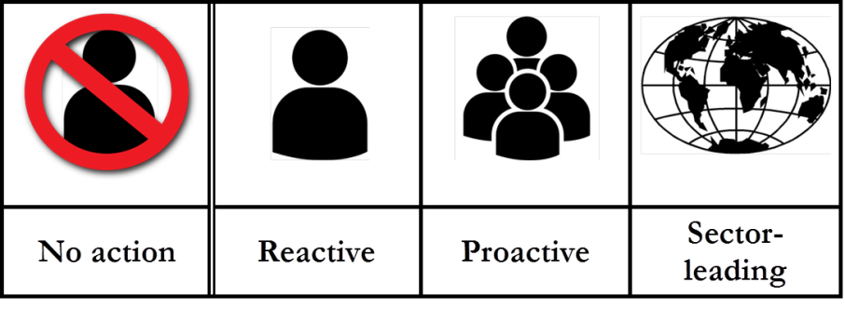

Slide 12


Example: online training
Online training
Level One | Level Two | Level Three
Rebadged online courses are provided and linked to from RDM pages. | Rebadged online courses are supplemented with some in-house, locally produced materials. | A significant proportion of locally produced online courses are available. These are reused by others in the sector.
Notes:
An example of various capabilities delivered around online training materials:

Slide 13
Service development strategy
Consider each service element individually
Assess your current capability
Define your target capability
Identify barriers and opportunities

Slide 14

Is this achievable?
Notes:
It’s important to ensure that there isn’t a wide gulf between your aspirations and what is realistic to achieve. That process of ensuring that your target capability is practical in your context is the focus for the group sessions that we will be taking part in today.

Slide 15

Thanks for listening!
DCC guidance, tools and case studies:
www.dcc.ac.uk/resources
Follow us on twitter:
@digitalcuration and #ukdcc

